Slide 1
Siemens Pilot – Update Pilot 1 - Securing the AI Supply Chain of Manufacturing Infrastrure
Project Meeting, Cagliari, Sardinia, Italy, 31 March & 1 April
Siemens

Slide 2
Goal of the Pilot 1 Workshop
Present the technical details of the Manufacturing pilot
Align pilot-specific requirements with CoEvolution-specific requirements
Identify technology needs for contributors in Pilot 1 to secure the AI supply chain
Define the mode of collaboration between partners

Slide 3

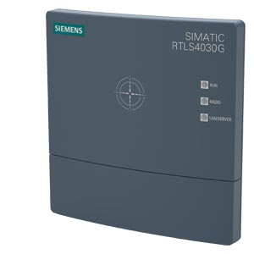
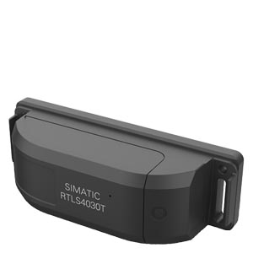
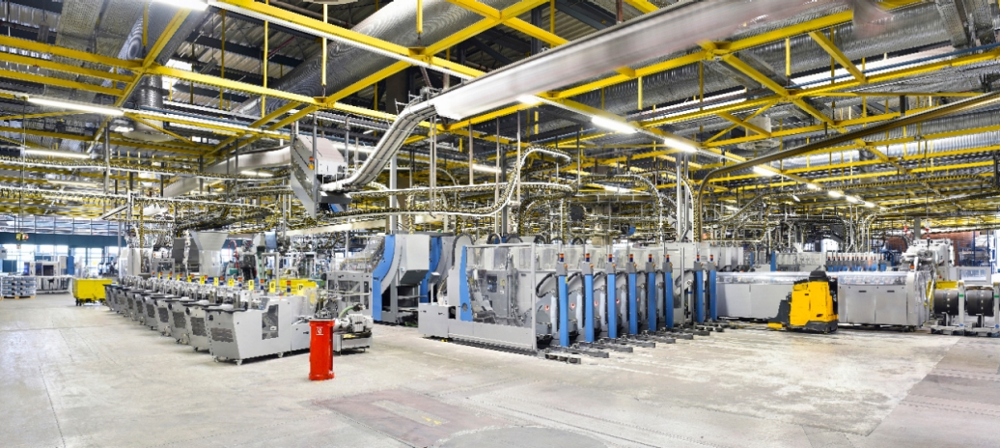
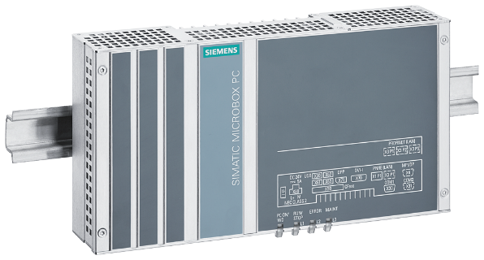
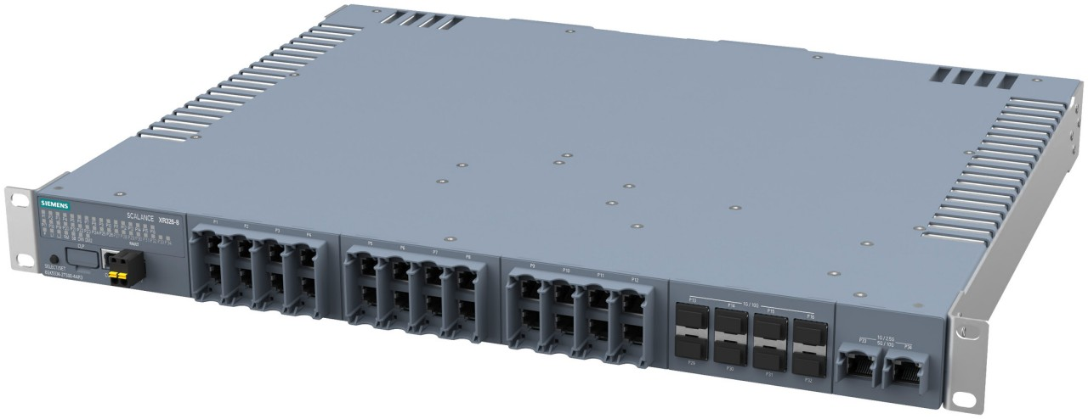
Technological Challenges
UWB system
2.a) Localization AI
Pretrained AI model is coming in from 3rd party or from another facility.
Questions:
Can we trust the AI model?
How can the supply chain be secured?
Can our model be misused?
2.b) Network/Edge Management AI
Networked edge system

Slide 4
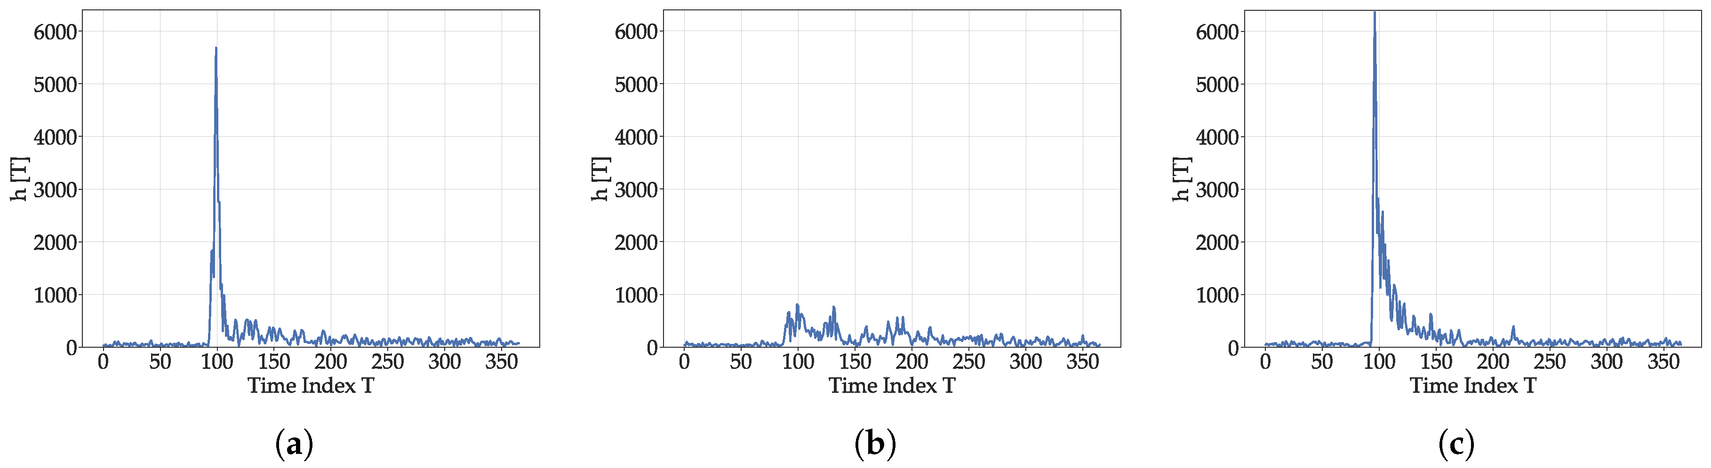

Use Case 1: AI-based localization in Industry
Channel Impulse Response (CIR)
AI is used in position calculation and learns good and bad signals.
transmit signal
receive
signal
Tracker
Anchor 1
Anchor 3
CIR
Anchor 2
Attenuations, reflections, etc.
add ranging error

Slide 5

Use Case 2: AI-based edge/network management
Users communicate with the system through natural language inputs
These inputs are processed through specialized language processing pipelines
The agent evaluates and selects appropriate information sources for effective knowledge retrieval
The agent identifies issues by analyzing logs and correlating them with telemetry data
The reasoning process concludes with generating actionable recommendations
The agent utilizes the system’s Web API to execute tasks and achieve the defined objectives
Industrial Edge AI
Hello! I'm your Industrial Edge Assistant. How can I assist you today?
Please, report the recent relevant events.
Overall, the system has been stable, with no major incidents, except on Tuesday. The app Camera AI app was restarted 130 times on edge device ALPHA1.
What could be the reason?
The app exceeded its memory limits, triggering restarts. These restarts coincide with high network utilization.
What do you recommend?
I suggest increasing memory limits by 50% to prevent further restarts. Additionally, moving Camera AI app to edge device ALPHA 2 is advisable due to high load.
Do it!

Slide 6
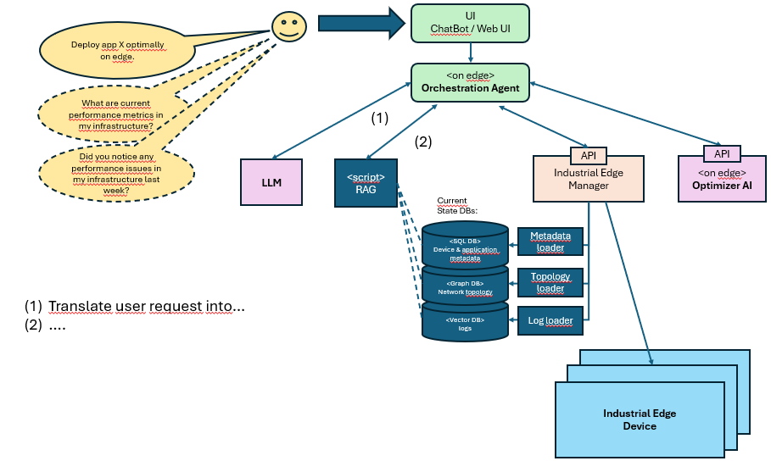
System Setup

Slide 7
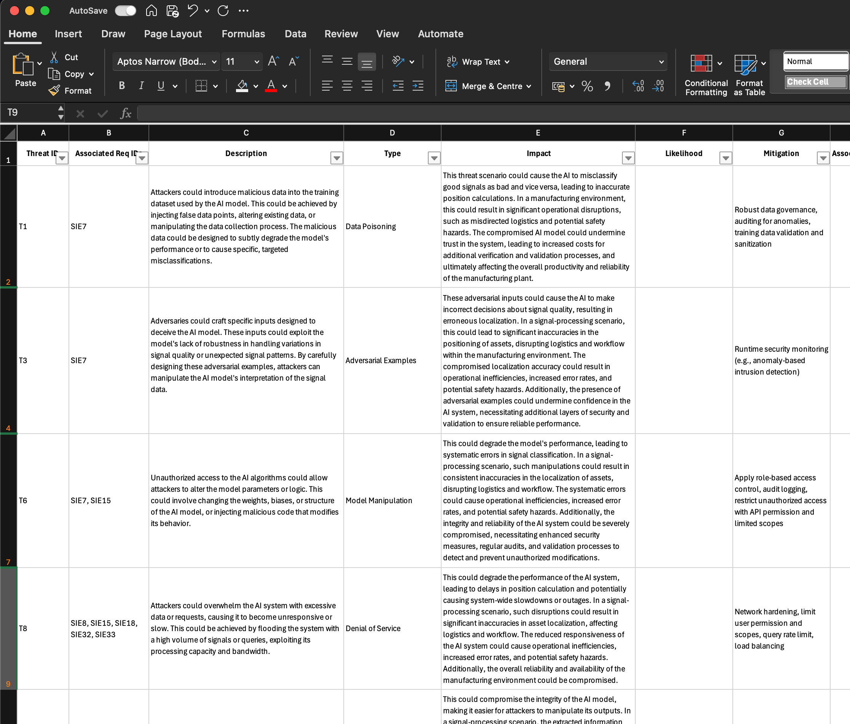
Pilot 1 Requirements / Threats
Requirements and threats are documented under WP3/Task 3.2 in the file CoEvaluation_UCRequirements_v01.xlsx
So far, the majority of collected requirements are non-CYS-related
Implementation of CYS-specific AI requirements requires dedicated project partner involvement
Collected threats need to be condensed and aligned with the security goals outlined in CoEvolution

Slide 9
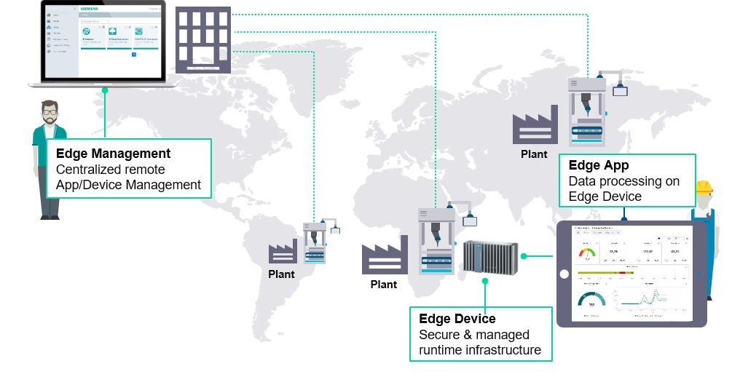
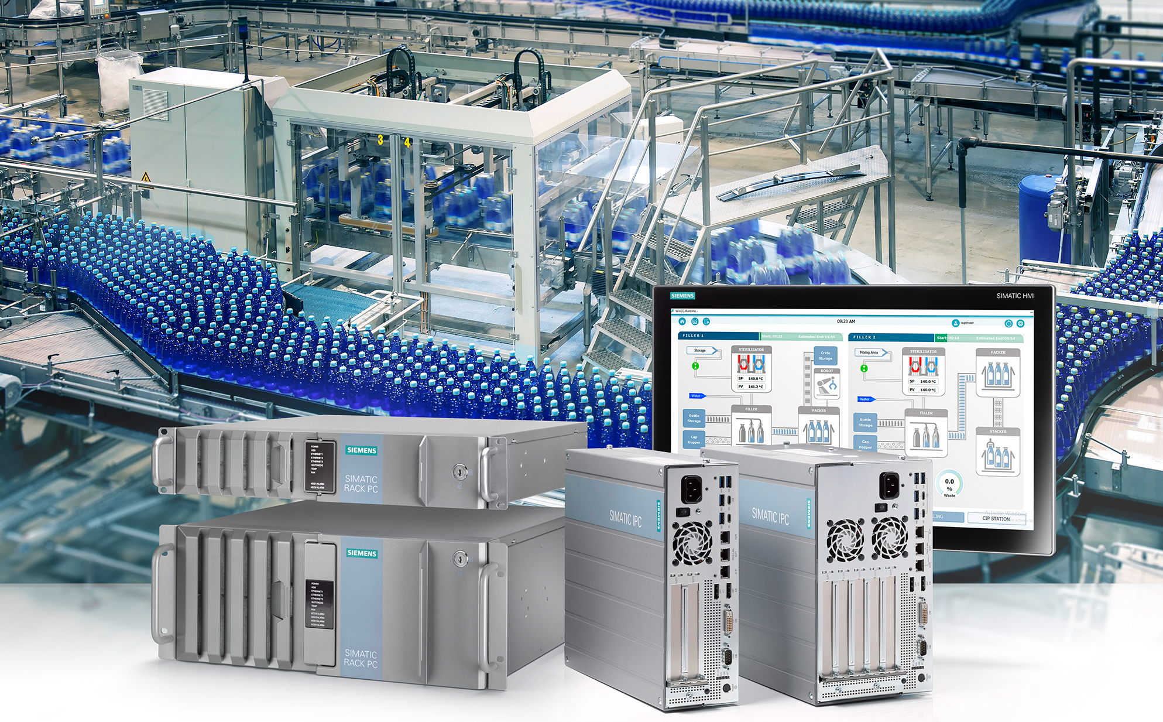
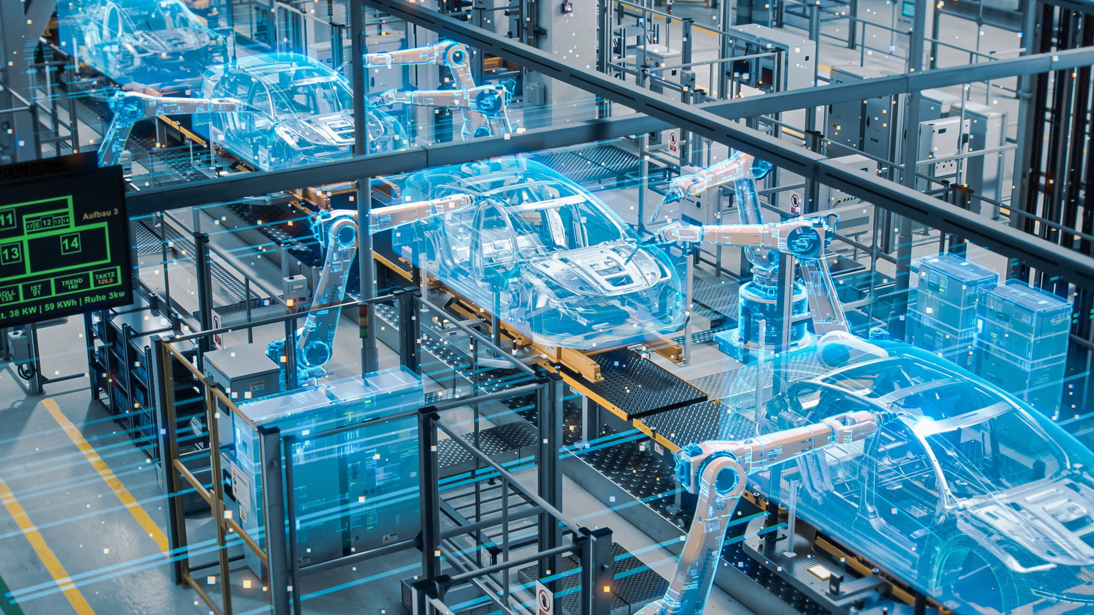

Description of the pilot environment/Infrastructure
“Industrial Edge” Product
Industrial PCs & Edge Apps
Data Collection
Data Analytics

